Slide 1
Analysis of Systems
Transfer functions
State-space representations
Block diagram manipulation
Relation of transfer function to pulse response
BIBO stability

Slide 2
Transfer Functions
The Z-transform has the same role in discrete-time systems that the Laplace transform has in the analysis of continuous-time systems.
If u(k) and e(k) are related by a difference equation, the transfer function, H(z), is defined as the ratio of the transform of the “output” u(k) of the system to the transform of the “input” e(k) of the system.

Slide 3
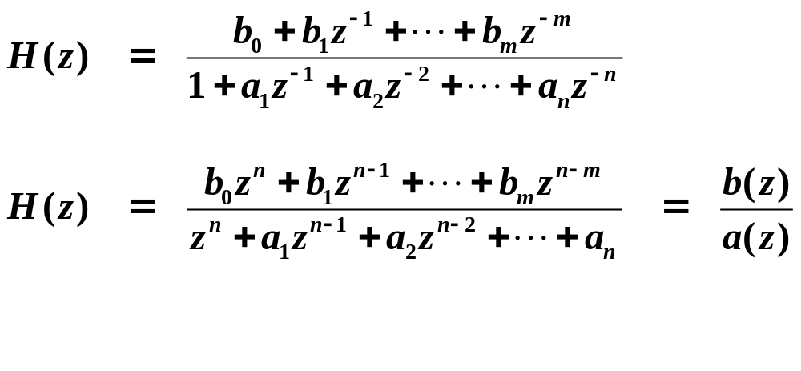
For a general difference equation:
Take Z-transform (and use the time-shift property):

Slide 4
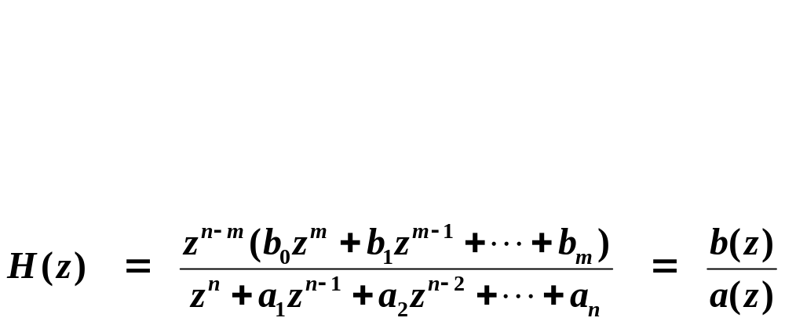
H(z) is a rational function of a complex variable.
  Solutions of b(z)= 0 are zeros of the transfer function.
  Solutions of a(z)= 0 are poles of the transfer function.
Special example

Slide 5
State-Space Representations
You should know how to convert an nth-order ordinary differential equation (O.D.E.) into a set of n 1st-order O.D.E.’s.
Similarly, an nth-order difference equation can be converted into a set of n 1st-order difference equations.
Often done because set of 1st-order equations is easier to solve.
Consider 3rd-order system as an example:
  There are many state-space representations of this system.

Slide 6
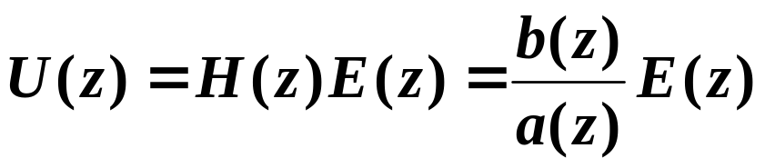
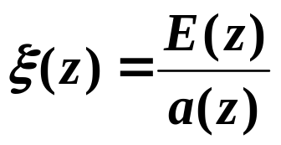
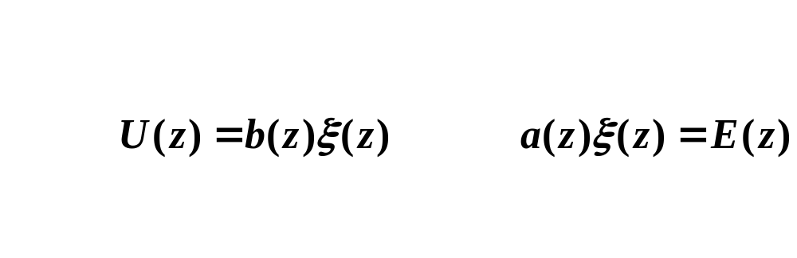
Control Canonical Form
Let
then and

Slide 7
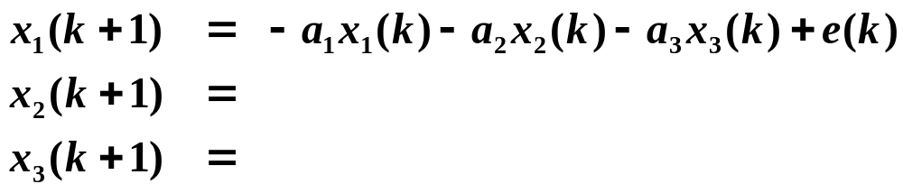
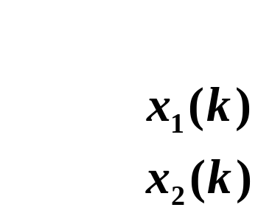
Block Diagrams of Systems
Can be drawn directly from state-space representations using only simple delay z ⁻¹ blocks, gains, and summers.

Slide 8
Control Canonical Form (and Observer Canonical Form, which we will discuss much later . . . ) is a Direct Canonical realization because all the gains in the block diagram are just the coefficients in the transfer function polynomials.
Will discuss Control and Observer forms more later . . .

Slide 9
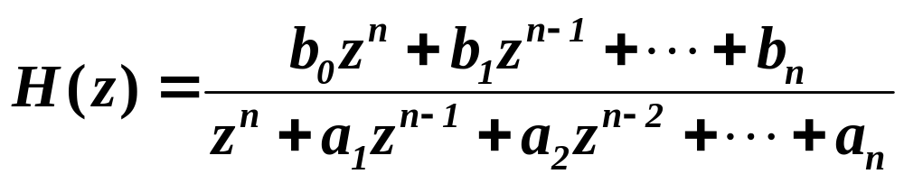
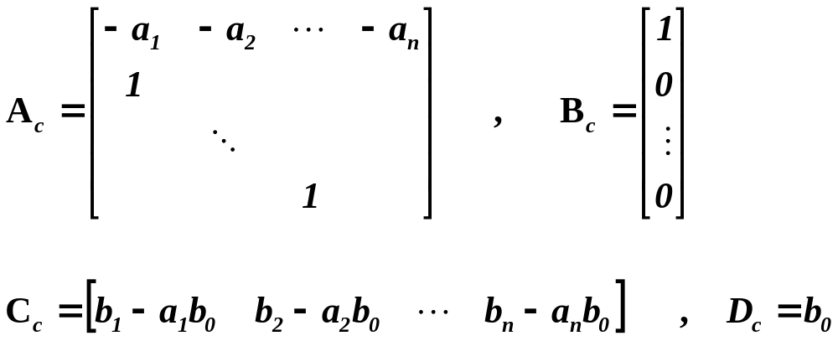
General Control Canonical Form for nth-order system

Slide 10



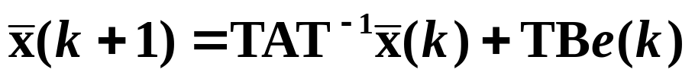
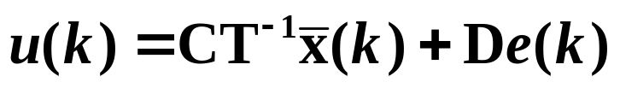
Non-Uniqueness of State-Space Representations
Any nonsingular transformation of state yields another state-space representation of the same transfer function.
Let

Slide 11






Block Diagram Manipulation
Four rules of block diagram manipulation, analysis, and
simplification:
Series/Product
Parallel/Sum
Σ

Slide 12
Single loops
Σ

Slide 13
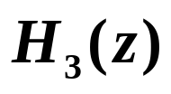
Moving nodes across blocks (or blocks across nodes)
Multi-path, multi-loop block diagrams can be simplified using
Above techniques
Mason’s rule

Slide 14




Relation of Transfer Function to Pulse Response
In continuous-time systems:
  The transfer function of a system is equal to the Laplace Transform of the impulse response.
We find a similar result in discrete-time systems:

Slide 15
BIBO Stability
Internal vs. External stability
  Internal stability is concerned with all the internal variables (states) of the system.
  External stability is concerned only with the output.
    BIBO stability is the most common type of external stability used:
      If for every Bounded Input, we have a Bounded Output, we say the system is BIBO stable.

Slide 16

A Test for BIBO Stability
can be given in terms of the unit-pulse response.
  First, consider a sufficient condition.
    Suppose the input e_{k} is bounded.
    The output can be written as
    Can we find a bound on the magnitude of the output?
      This condition is also necessary . . .

Slide 17
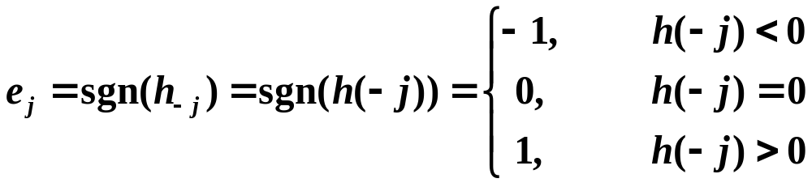
Consider the input
Above provides requirement on unit-pulse response h_{k} .
a bounded input . . .

Slide 18
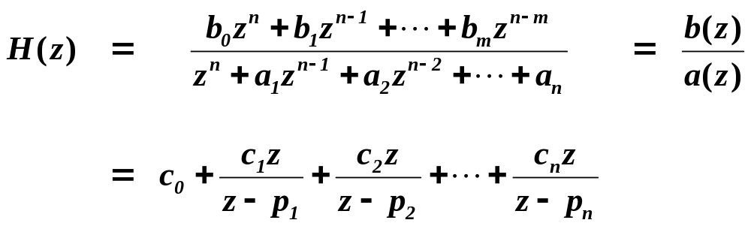

What are the requirements on H(z) for BIBO stability?
  That is, what are the requirements in the frequency domain?

Slide 19
Example
Suppose in our general difference equation
that all the coefficients are zero except a₁ and b₀ .
What is the unit-pulse response?
Is the system BIBO stable? Or, under what specific conditions will the system be BIBO stable?

Slide 20
Jury Test
Provides a quick way to determine by hand whether the roots of a polynomial are all inside the unit circle.
Analogous to Routh Test for continuous-time systems
Useful for determining stability of a class of systems where certain parameters may not have fixed quantities.

